Slide 1
Exploratory Data Analysis With Pandas
Overview
In this lesson, students will begin using Pandas for exploratory data analysis. This will include filtering and sorting data to generate insights.
Duration 120 minutes
Learning Objectives
In this lesson, students will:
Use Pandas to read in a data set.
Use DataFrame attributes and methods to investigate a data set's integrity.
Apply filters and sorting to DataFrames.

Slide 2
Pre-Class Materials and Preparation
For remote classrooms: Virtual breakout rooms and Slack may be needed to facilitate the partner exercise and discussions. As you plan for your lesson:
Consider how you'll create pairs for the partner exercise (randomly, or with pre-assigned partners).
Determine how (if at all) exercise timing may need to be adjusted.
For helpful tips, keep an eye out for the For remote classrooms tag in the speaker notes.
Prepare screenshots and answers to exercises in advance so that they can be easily shared in Slack during your lecture.

Slide 3
Suggested Agenda
Time | Activity
0:00–0:50 | Welcome + Meet Pandas
0:50–1:00 | Break
1:00–1:50 | Filtering and Sorting Data
1:50–2:00 | Wrapping Up, Q&A, and Exit Ticket Completion

Slide 4
Jupyter Notebook
The exercises referred to in this lesson can be found in the Python Workbooks + Data folder.

Slide 5
Exploratory Analysis With Pandas
Notes:
Duration: 5 minutes

Slide 6

Our Learning Goals
Use Pandas to read in a data set.
Use DataFrame attributes and methods to investigate a data set’s integrity.
Apply filters and sorting to DataFrames.
Notes:
Purpose: Set expectations for the lesson.
For remote classrooms:
Capture a screenshot of this slide and drop it in the class Slack channel.

Slide 7
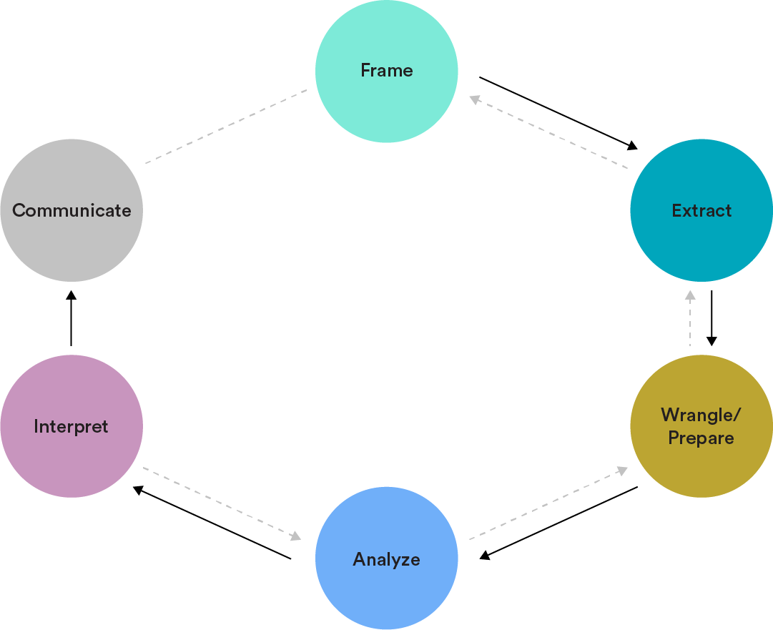
The Data Analytics Workflow
Extract: Select and import relevant data.
Wrangle/Prepare: Clean and prepare relevant data.
Analyze: Structure, comprehend, and visualize data.
Notes:
Purpose: Set the context for this lesson in terms of the Data Analytics Workflow.

Slide 8
Meet Pandas
Exploratory Data Analysis With Pandas
Notes:
Duration: 45 minutes

Slide 9

What Is Pandas?
Pandas is the most prominent Python library for exploratory data analysis (EDA). We use Pandas to investigate, wrangle, and clean our data.
Pandas is a versatile toolbox that can be used for all of our data exploration needs. (Think Excel or Google Sheets, but much faster and with way more flexibility!)
Notes:
Purpose: Introduce Pandas.

Slide 10

Exploratory Data Analysis: Definition
In a nutshell, exploratory data analysis (EDA) means “getting to know” a data set. This can include:
Checking data types to make sure data is stored properly.
Calculating summaries for columns, like the average, minimum, or maximum.
Evaluating your data set for missing data.
Identifying potential trends or outliers.
Basic visualization of your data.
Notes:
Purpose: Define EDA.
TALKING POINTS:
It's common to reach a later point in the Data Analytics Workflow only to realize that unclean data or a particular feature could have be engineered earlier in the process.
Exploring the data first makes working with it later much more reliable.
Hypothesis-driven EDA is essential for effective EDA, otherwise, we would be endlessly mining our data for answers.

Slide 11

Exploratory Data Analysis Best Practices
At the very least, as part of EDA, you should determine:
The number of rows in the data set.
What does each row represent? Is each row a person, an observation, a time point?
The number of columns in the data set.
What does each column represent? How was that data collected? Try using a data dictionary — it can often directly answer these questions for you!
Notes:
Purpose: Explain where to begin when it comes to EDA.

Slide 12

From Questions to Hypotheses
Start by asking yourself…
What fields can I COMBINE to find interesting insights?
What ACTIONS can someone take as a result of my charts and analyses?
Notes:
Purpose: Emphasize the importance of having a goal for analysis.
TALKING POINTS:
One of the most challenging parts of data analytics can be turning business questions into analyses, or even forming your own questions when the request you receive is vague.
You can start by asking these two questions.
Answering them will also help you figure out what to do with your projects.

Slide 13
Reading a Data Set
Pandas makes it easy to import a data set using a method for reading .csv files.
import pandas as pd
data_frame = pd.read_csv(file_address,sep=delimiter_character)
Note: Not all .csv files use commas! sep defines the character used to separate values.
Notes:
Purpose: Introduce how to read in a data set with Pandas.

Slide 14
Series vs. DataFrames
Pandas relies on two key objects, each with their own methods and properties:
A Series, accessed using single square brackets, is an attribute of the larger DataFrame object and can only access one column.
data_frame['column_name']
A DataFrame, accessed using double square brackets, treats the output as its own smaller table and can include multiple columns.
data_frame[['column_name']]
data_frame[['column_a', 'column_b']]
Notes:
Purpose: Distinguish between Series and DataFrames.
TALKING POINTS:
When looking at documentation, be clear whether you're looking at a Series or a DataFrame and always be sure of which one you're working with at any particular point in code.

Slide 15
Accessing and Modifying the Index
Much like lists, DataFrame rows also have an index to keep of them.
While the default index starts at zero (remember that Python starts counting at zero!), there may already be a column in the data itself that we’d prefer to use as the index.
data_frame.index
data_frame.set_index(column_name, inplace=True)
Notes:
Purpose: Discuss why you might change the index of a DataFrame.
TALKING POINTS:
Make special note of the inplace keyword argument that will recur throughout Pandas.
Do we want to actually modify the original data set (inplace) or simply create a new copy to store in a variable (the default, False)?
We will cover this later in the lesson.

Slide 16
Columns and Data Types
One of the first things we want to learn about a new table is what columns and data types we’ll be working with in that table.
data_frame.columns # Prints all the column names.
data_frame.dtypes # Prints all the data types, but is hard to read!
# Easy-to-read DataFrame of the data types:
pd.DataFrame(data_frame.dtypes, columns=['DataType'])
Notes:
Purpose: Introduce basic DataFrame methods used for EDA.

Slide 17
Why Investigate Data Types?
Why would we be interested in the data types as one of our first questions?
What operations might we perform in response to the data types we see?
Notes:
Purpose: Get students to think through the significance of understanding data types.
TALKING POINTS:
Data types can interfere with calculations and operations, thus, we may have to use type casting to convert column types when working with them in terms of comparisons, calculations, and so on.

Slide 18
Renaming Columns
We can use the .rename() method to provide a dictionary of replacement names:
df.rename(columns={'OldName': 'NewName'}, inplace=True).head(3)
The inplace option determines whether we’re creating a new DataFrame or modifying the original directly. inplace=True means we are overwriting the original!
Notes:
Purpose: Walk students through how to rename columns.
TEACHING TIPS:
Feel free to demonstrate other ways of renaming columns if you'd like.
When introducing topics, it can be needlessly complex to throw out multiple options, so, for now, try recommending just one specific way of renaming columns.

Slide 19
Common Column Operations
 | What This Method Does
.describe() | Provides summary attributes, including maximum, minimum, mean, and the 25%, 50%, and 75% quartile values (for numeric columns) or most frequent value (for categorical columns).
.value_counts() | Counts the number of occurrences of each value in the column.
.unique()/ .nunique() | Provides a list of unique values or the number of unique values.
Notes:
Purpose: Introduce basic column operations.
TALKING POINTS:
Note that you must grab the column to use these methods, i.e., df['Color'].value_counts().

Slide 20

8.1 Exploring the Superstore Data
15 minutes
We’ll use the Superstore data set to practice exploring data with Pandas.
We will be looking at a single table from this database — the “Orders” table — to explore its properties.
Notes:
Purpose: Walk students through performing basic EDA using Pandas.
TEACHING TIPS:
Run through each of the cells and discuss the patterns one follows when encountering a data set for the first time.
In order to demonstrate how to read Pandas docs, you could also pretend to forget a specific method and then consult the documentation, noting that Pandas has fairly efficient and clear documentation.

Slide 21

8.2 Explore Another Table
20 minutes
Answer the questions in Section 8.2 by using the column operations methods.
You may want to start with some of the same exploratory methods we just used.
Notes:
Purpose: Give students time to independently practice Pandas.

Slide 22
Filtering and Sorting Data
Exploratory Data Analysis With Pandas
Notes:
Duration: 50 minutes

Slide 23
Filtering on One Condition
Filtering and sorting are important steps that allow us to drill into subsets of our data.
To filter, we use a process called Boolean filtering, wherein we first define a Boolean mask and then use it to filter our DataFrame.
Notes:
Purpose: Introduce filtering in Pandas.
TALKING POINTS:
Filtering is how we start to split our data and generate meaningful insights based on the differences in various subsets.
While basic exploratory methods are nice, more insights come from splitting, combining, and comparing subsections of data.

Slide 24
The Boolean Mask
Index
1 | False
2 | False
3 | False
4 | False
5 | True
6 | True
7 | True
8 | False
We can create a whole series of True and False values by using a comparison statement with the column:
df['Column'] == 'ValueDesired'
Notes:
Purpose: Explain how Boolean mask is used for filtering.

Slide 25
The Boolean Mask (Cont.)
Once we have a Boolean series, we can then filter the entire data set for only those values with a True result:
df[df['Column'] == 'ValueDesired'].tail(3)
Index | Column | Price
317 | ValueDesired | 10.99
318 | ValueDesired | 5.00
319 | ValueDesired | 2.75
Notes:
Purpose: Explain how Boolean mask is used for filtering.
TALKING POINTS:
Note that we can use other comparisons besides simple equality.
Any Boolean result based on a column comparison will work.

Slide 26
DataFrame Syntax Chaining
When filtering with this syntax, the result is a DataFrame.
This means that we can continue accessing other columns or using methods:
# Access the Price column of all results passing the filter:
d[df['Color'] == 'Purple']['Price']
# Gives numerical summaries based only on results passing the filter:
df[df['Color'] == 'Purple']['Price'].describe()
Notes:
Purpose: Demonstrate how methods can be combined.
TALKING POINTS:
The result of this filtering will be the entire DataFrame, so you can continue on with DataFrame methods after filtering.

Slide 27
Filtering by Multiple Conditions
Adding more conditions uses the same syntax, even if it looks more complicated:
df[(df['Color'] == 'Silver') & (df['ListPrice'] > 350)]
df[(df['ListPrice'] < 3000) | (df['ZipCode'] == '95404')]
The parentheses here are very important! Leaving them out will usually trigger an error.
Notes:
Purpose: Demonstrate additional filtering approaches.
TALKING POINTS:
You can get even more complex with your conditions, but don’t forget to use parentheses to group conditions together.

Slide 28

8.3 Boolean Filtering
15 minutes
Use Boolean filtering to narrow down the DataFrame in Section 8.3 of your workbook.
Notes:
Purpose: Give students time to practice filtering.

Slide 29
Sorting
The magic of libraries like Pandas is that there’s a method for almost everything. In the case of sorting, we have a sort_values() method:
# For a Series object, no need to specify column: There's only one!
data_series.sort_values()
# For a DataFrame, it will sort by index unless given a column name.
data_frame.sort_values(by='column_name', descending=True)
Notes:
Purpose: Introduce how to sort in Pandas.
TEACHING TIPS:
This is a good opportunity to reiterate the difference between Series and DataFrame objects.
Both can be sorted, but with a DataFrame you may need to provide the specific column by which to sort.

Slide 30
Accessing an Individual Row
Now that we can sort and filter, it’s more likely that we might want to access a single row of data from a DataFrame. We can use the iloc property to use indexing syntax, like so:
data_frame.sort_values(by="points_scored").iloc[ [0] ]
Note the two brackets, which mean that the result will be a DataFrame. We could also simply use one bracket to instead return a Series with accessible properties:
data_frame.sort_values(by="points_scored").iloc[0]["player_name"]
Notes:
Purpose: Demonstrate how to access a single row of data.

Slide 31
Key Definitions Recap
While working with Pandas, it will be important to distinguish between Series and DataFrames objects.
What are the key properties of each type of object?
What are their differences and similarities?
Notes:
Purpose: Review the key definitions and properties covered in the lesson.

Slide 32

8.4 Sorting and Filtering
25 minutes
Use sorting and filtering methods to explore the attributes of a data set and answer stakeholder questions.
Notes:
Purpose: Give students time to practice working with Pandas.
TEACHING TIPS:
Encourage students to search the documentation if and when they get stuck: https://pandas.pydata.org/pandas-docs/stable/index.html.

Slide 33
Wrapping Up
Exploratory Data Analysis With Pandas
Notes:
Duration: 10 minutes

Slide 34
Recap
Looking Ahead
In today's class, we…
Used Pandas to read in a data set.
Used DataFrame attributes and methods to investigate a data set's integrity.
Applied filters and sorting to DataFrames.
On your own:
Work through the Python progress assessment on myGA (due at the end of the unit).
Share your capstone project ideas with your instructor for review.
Join someone else’s project or invite others to join yours!
Next Class:
Data Visualization With Pandas
Notes:
Purpose: Recap what was covered in the lesson.

Slide 35

Don't Forget: Exit Tickets!

